Slide 1
DATA STORYTELLING STATISTICAL VALIDATION
PRESENTED BY
Navya Sri Gongu

Slide 2
Project Objective
Analyze customer purchasing behavior
Understand impact of discounts
Identify high-value customer groups
Use statistical testing for validation
Provide business recommendations

Slide 3
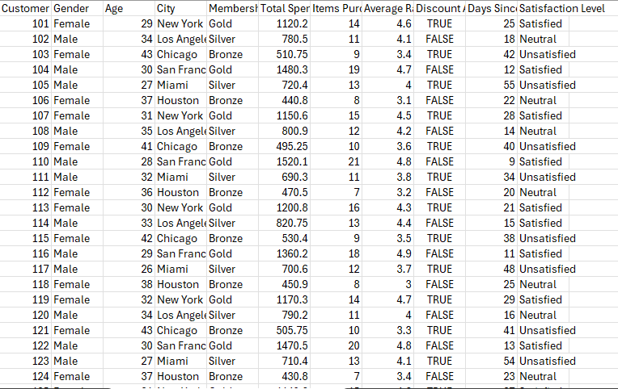
Dataset Overview
Dataset Information
Source: Kaggle
Type: E-Commerce Customer Data
Records: 1000+
Format: CSV
Important Features
Gender
Age
Membership Type
Total Spend
Discount Applied
Satisfaction Level

Slide 4
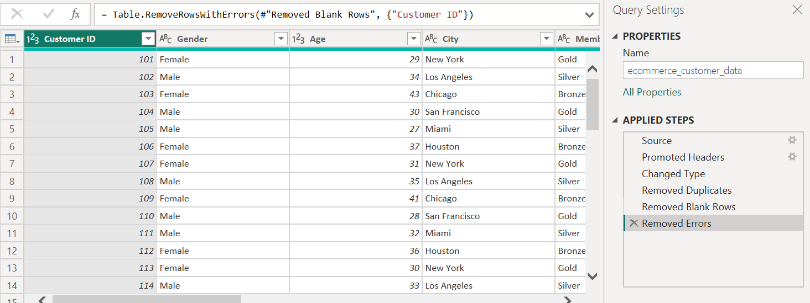
Data Cleaning Process
Data Cleaning Steps
✔ Removed null values
✔ Removed duplicates
✔ Corrected data types
✔ Renamed columns
✔ Verified data consistency

Slide 5
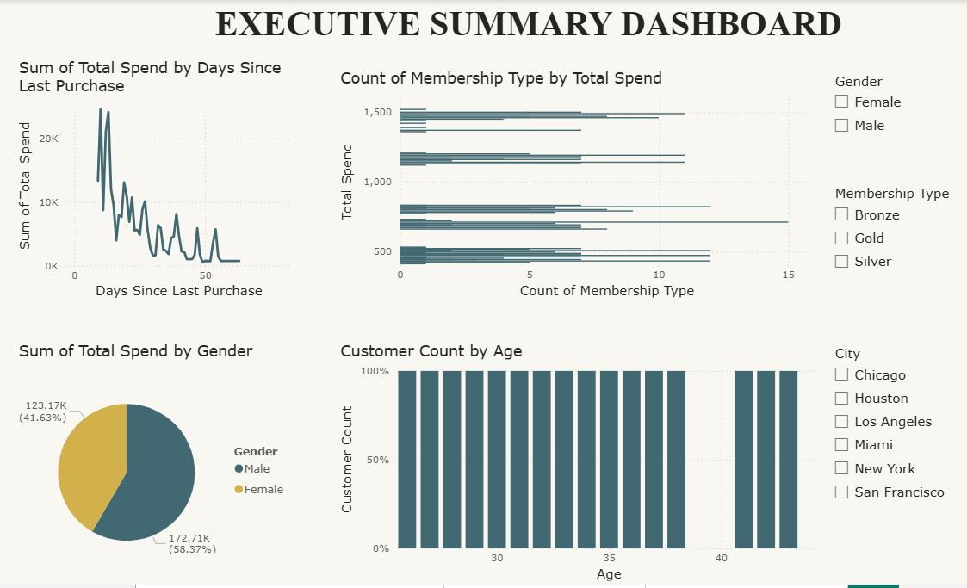
Dashboard Overview
Dashboard Includes
KPI Cards
Revenue Analysis
Membership Insights
Discount Analysis
Customer Satisfaction

Slide 6
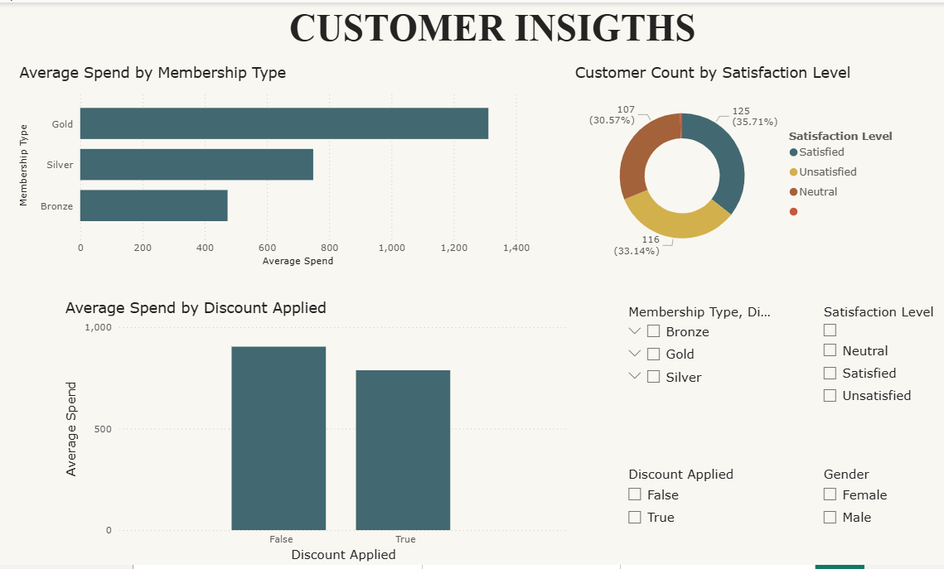
Dashboard Includes
✔ Premium members spend the most
✔ Younger customers are more active
✔ Female customers contribute high revenue

Slide 7
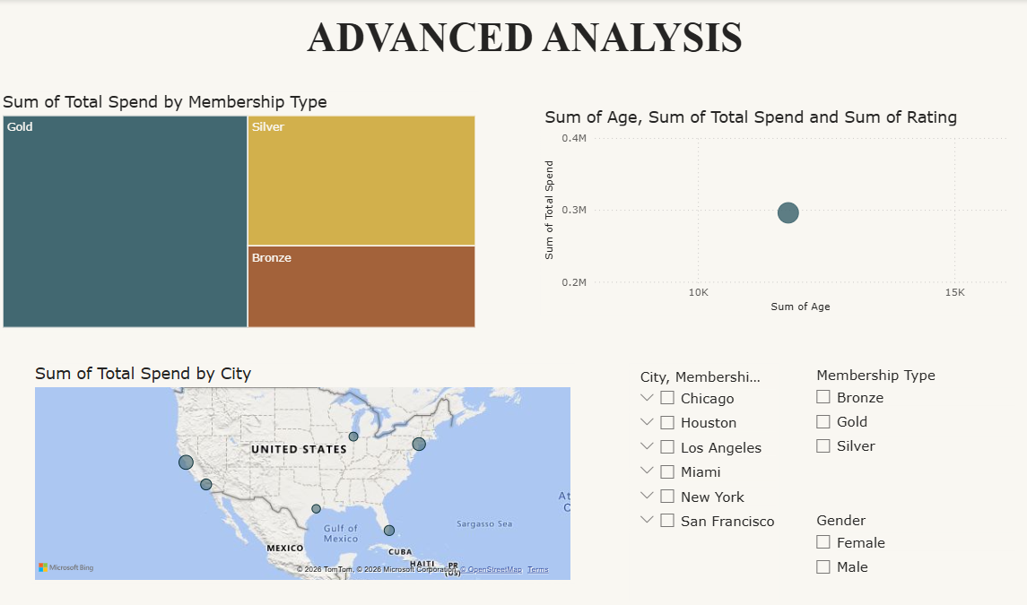
Dashboard Includes
Customers using discounts show higher average spending behavior.
Promotional campaigns can increase customer engagement and sales.

Slide 8
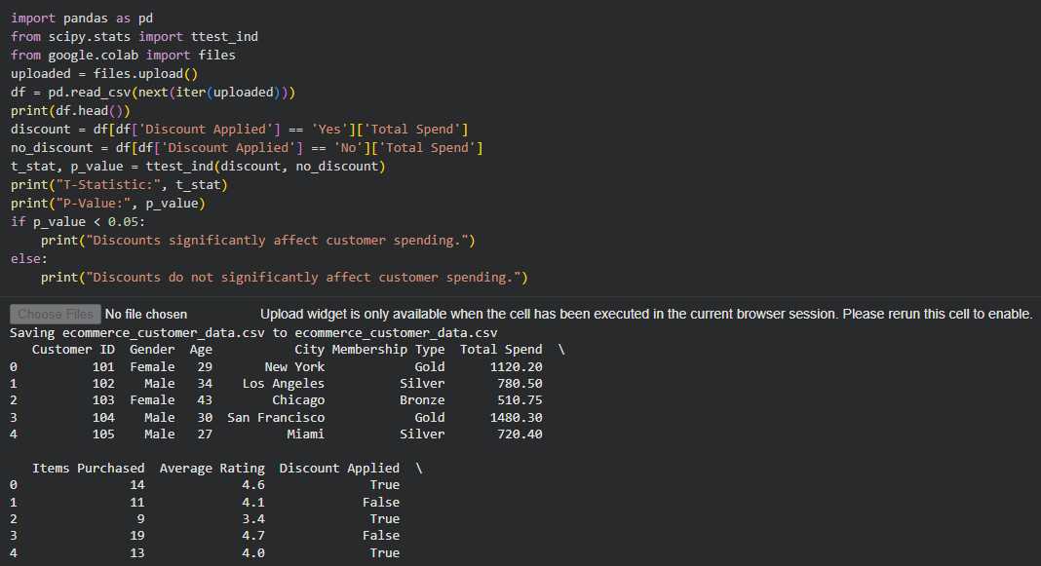
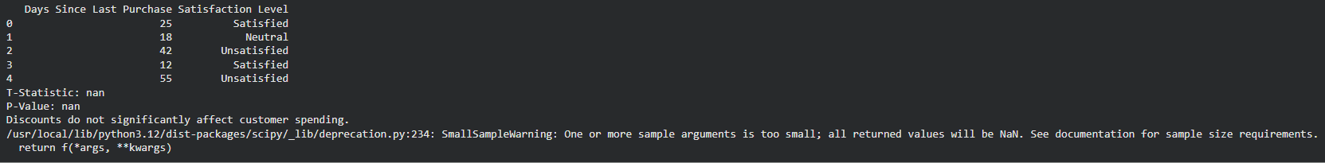
Statistical Validation
Null Hypothesis (H₀)
Discounts do not affect customer spending.
Alternative Hypothesis (H₁)
Discounts significantly affect customer spending.
Statistical Test:
Independent T-Test

Slide 9
Recommendations
✔Increase loyalty program benefits
✔Use targeted discount campaigns
✔ Improve customer satisfaction
✔Focus on high-spending customers
✔ Use personalized marketing

Slide 10
Business Impact
Increased customer retention
Improved sales opportunities
Better customer segmentation
Data-driven decision making

Slide 11
Conclusion
The Data Storytelling and Statistical Validation project successfully analyzed the E-commerce Customer Behavior dataset to identify meaningful business insights and customer trends. Through data cleaning, visualization, exploratory analysis, and hypothesis testing, the project transformed raw data into actionable information for decision-making.

Slide 12


Slide 13


